Slide 1
2.4 GHz CubeSat Communications System
Robert Bui
Communications Subsystem Lead

Slide 2
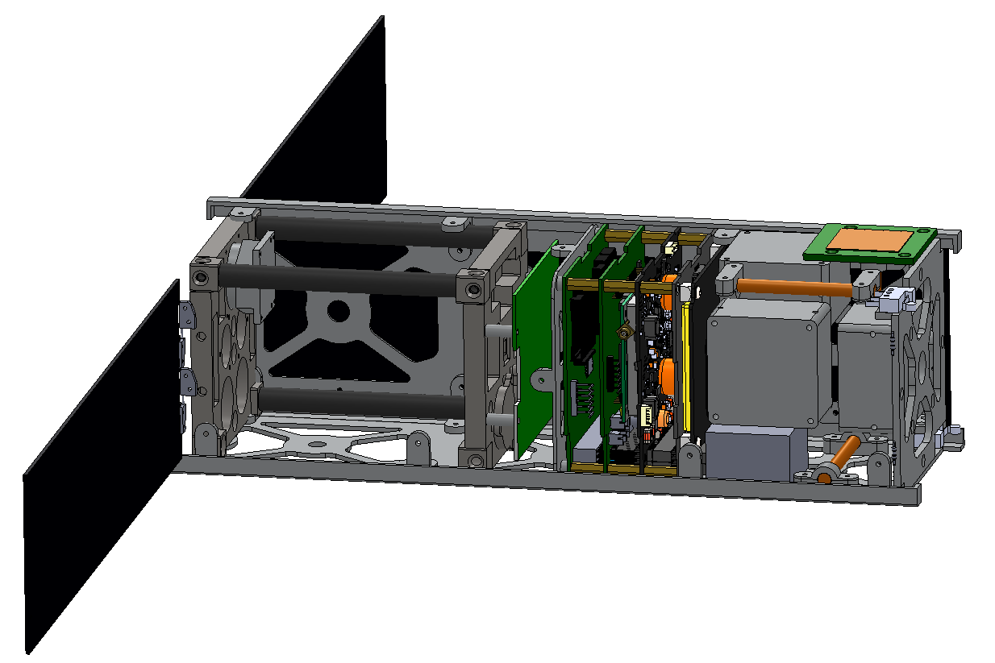
Overview
Patch
Antenna
Communications System Overview
SDS-1 Communications Description
Ground Station Description
Link Budget Summary
Transceiver
The SDS-1 Cube Satellite

Slide 3
Objective
Create and ensure a reliable data link between the SDS-1 and the ASU ground station for transmitting and receiving telemetry, commands and photos.
Operate using the 13 cm amateur ham radio band at the frequencies of 2400-2450 MHz.

Slide 4
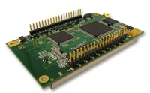
SDS-1 Communications System
Transceiver (MHX-2420)
Link Rate: 19.2 - 230.4 kbps
Frequency: 2.4000- 2.4835 GHz (FHSS)
Transmit and Receive Bandwidth: 280 kHz
Sensitivity: -107 dBm
FEC and 32 bits CRC
Max Output Power: 1 W
MHX-2420
(Courtesy of Microhard Systems Inc.)

Slide 5
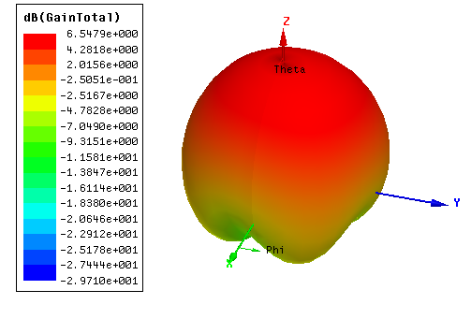
SDS-1 Communications System
Patch Antenna (30 mm x 30 mm)
Expected Gain:
6 dBi (Boresight)
4 dBi (± 30˚)
0 dBi (± 60˚)
Circularly Polarized
Radiation Pattern of the Patch Antenna

Slide 6
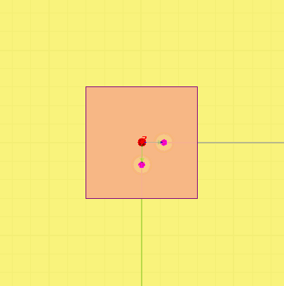
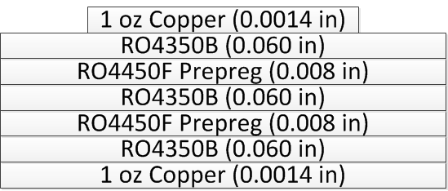
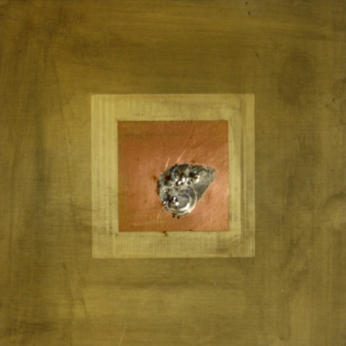
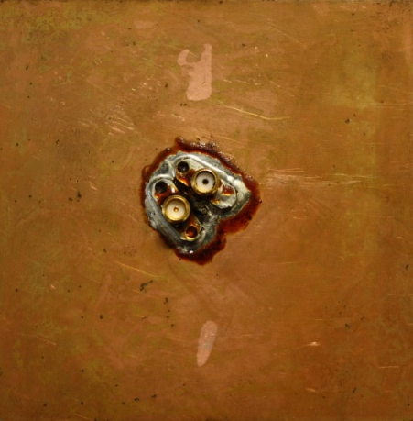
SDS-1 Communications System
Patch Antenna
Composition of the
Patch Antenna
Front Side
Back Side

Slide 7
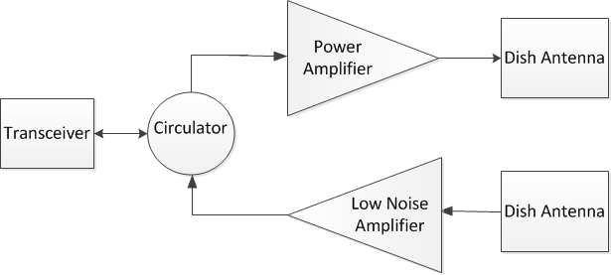
Ground Station
Two 30 dBi
Dish Antennas
Linearly Polarized
Beam Width: 5.3˚
Azimuth/Elevation Rotators
Tracking Software
MHX-2420
Ground Station Design

Slide 8
Link Budget Summary
Orbit Altitude – 350 km
Without LNA
Space Craft Elevation Angle | deg | 10 | 45 | 90
Received Signal Strength | dBm | -110.3 | -101.7 | -98.9
MDS | dBm | -107 | -107 | -107
Link Margin | dB | -3.3 | 5.3 | 8.1
With LNA
Space Craft Elevation Angle | deg | 10 | 45 | 90
Received Signal Strength | dBm | -112.3 | -103.7 | -100.9
MDS | dBm | -116 | -116 | -116
Link Margin | dB | 3.7 | 12.3 | 15.1

Slide 9
Future Work
Test patch antenna in ASU’s EMAC facility and finalize design.
Assemble ground station.
Perform communication tests between the ground station and patch antenna.
Integrate the patch antenna with the SDS-1.

Slide 10
Questions or Comments?
Name: Robert Bui
Website: http://sdsl.club.asu.edu/
Email: sdsl@asu.edu
or robert.bui@asu.edu

